Slide 1
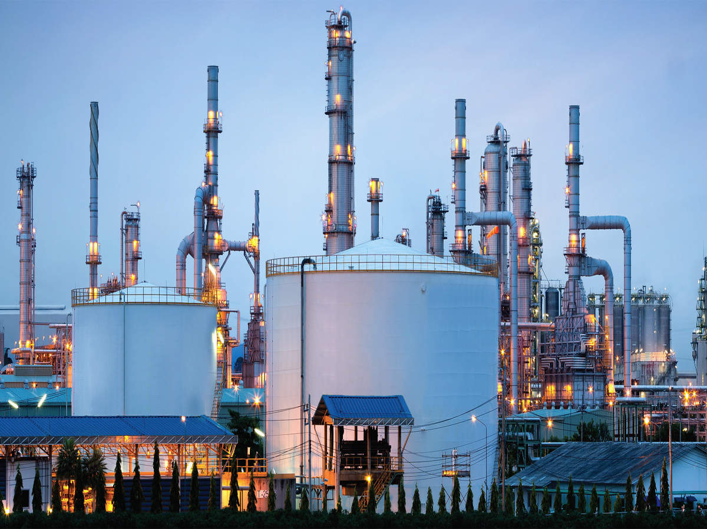


Executive Summary
Pre-Feasibility Report
PVC & Phenol: India
October 27, 2022
Prepared For
Prepared By
MARKET INTELLIGENCE . CONSULTING
www.techscireserach.com

Slide 2

Contents
04
PVC
Phenol
PVC + Phenol
Annexure
24
46
50

Slide 3
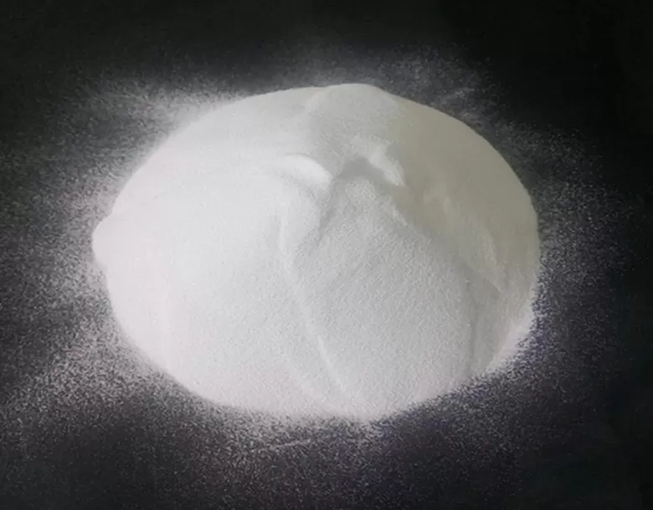
PVC

Slide 4
India: Manufacturing Landscape
East
India Polyvinyl Chloride (PVC) Capacity, By Company (000’ Tonnes)
West
Paradip: IOCL (Planned)
Hazira: RIL
Vadodara: RIL
Dahej: RIL
Dahej: RIL (Planned)
Dahej: OPaL (Upcoming)
4. Mundra: Adani (Planned)
5. Ratnagiri: Finolex
6. Kota: DCM Shriram
Company | Technology Provider | Capacity, FY2021
Reliance Industries Limited | BF Goodrich, USA (now known as Oxy Vinyl) | 755
Finolex Industries Limited | Uhde, Germany | 272
Chemplast Sanmar Limited | BF Goodrich, USA (now known as Oxy Vinyl) | 366
DCW Limited | Atochem, France | 90
DCM Shriram Limited | Kureha technology | 70
6
4
3
1
2
1
All manufacturers offer suspension grade.
5
Finolex Industries Limited & Chemplast Sanmar Limited also offer emulsion grade.
South
Cuddalore: Chemplast
Cuddalore: Chemplast (Planned)
2. Mettur, Chemplast
3. Tuticorin, DCW Ltd.
2
1
3
PVC
Source: TechSci Research

Slide 5
India: Capacity, Production
India Polyvinyl Chloride (PVC) Capacity and Production, By Volume (000’ Tonnes), 2010 - 2040F
Upcoming PVC Plant details
Upcoming Greenfield / Brownfield Projects will intensify the competition.
Company Name | Expected Capacity | Type of Process | Status
Indian Oil Corporation Limited | 500KTPA | EDC / VCM to PVC | Availability of chlorine is a major challenge (Location Disadvantage)
Adani Enterprises Limited | 1000KTPA | Coal to PVC | Submitted proposal for environmental clearance in April 2021.
Chemplast Sanmar Limited | 236 KTPA (Brownfield Expansion) for Suspension Grade PVC | VCM to PVC | Received the environmental clearance and the project is in initial phase.
Reliance Industries Limited | 1000 KTPA of Brownfield Expansion to produce S-PVC, Emulsion grade and C-PVC | Ethylene to PVC | Received the environmental clearance and. the project is in initial phase, expected to be commissioned by FY 2026.
ONGC Petro additions Limited | 350 KTPA Greenfield Expansion | Ethylene to PVC | The project is in Initial stage and is expected to be commissioned by FY 2027.
PVC
Source: TechSci Research

Slide 6
India: Demand
India Polyvinyl Chloride (PVC) Demand, By Volume (000’ Tonnes), 2010-2040F
India Polyvinyl Chloride Demand Supply Gap, 2010-2040F (000’ Tonnes)
Parameters | 2010 | 2015 | 2021 | 2022E | 2025F | 2030F | 2040F
Capacity | 1327 | 1501 | 1553 | 1553 | 1807 | 4157 | 4157
Production | 1191 | 1354 | 1376 | 1388 | 1580 | 4050 | 4050
Import | 659 | 1293 | 1595 | 1786 | - | - | -
Export | 0 | 2 | 75 | 27 | - | - | -
Inventory | 20 | 23 | 25 | 26 | - | - | -
Demand | 1830 | 2622 | 2870 | 3121 | 3791 | 5351 | 10802
Demand (Y-O-Y Growth Rate, %) | - | 15.63% | -18.01% | 8.74% | 6.85% | 7.31% | 7.00%
Demand - Supply Gap | - | - |  | (1733) | (2211) | (1301) | (6752)
CAGR 2010-2021 | CAGR 2022E-2030F | CAGR 2031F-2040F
4.18% | 6.97% | 7.27%
Demand-Supply Gap arguments the need for new player, even post-realization of ongoing/upcoming Greenfield/Brownfield Projects
Growing construction and agriculture sector is pushing the demand of PVC in India.
Government’s focus on Infrastructure development and low per capita consumption @ 2.24 kg, to drive future growth of the product.
India will become world’s third largest construction market by 2030, adding 12.7 million homes a year to become a USD1 trillion market
uPVC Windows market is growing at a CAGR of 10% because of growing acceptance by Indian Builders and Architects boosting. There is effort to introduce IS standard
Better market capitalization and lucrative demand of PVC in pipes and fittings.
AatmaNirbhar Bharat” and “Make in India” policies are pushing domestic manufacturer to produce green field capacity to promote domestic manufacturing in the country.
PVC
Source: TechSci Research

Slide 7
India: Demand—Grade, End-Use,Type
India Polyvinyl Chloride (PVC) Demand, By Type, By Volume, 2010–2040F (000’ Tonnes)
Suspension Grade is the most prominent type
Suspension Grade PVC
Used in manufacturing pipes and conduits.
Emulsion Grade PVC
Used for paste resin, battery separator plate, and copolymer resin.
Total | 1,830 | 2,622 | 3,501 | 2,870 | 3,121 | 3,791 | 5,351 | 10,802
India Polyvinyl Chloride (PVC) Demand, By End Use, By Volume (000’ Tonnes), 2010–2040F
India PVC Demand by Rigid & Flexible Type
Pipes & Fittings is the most prominent end-use
Rigid PVC is the most prominent type
Total | 1,830 | 2,622 | 3,501 | 2,870 | 3,121 | 3,791 | 5,351 | 10,802
Total | 1,830 | 2,622 | 3,501 | 2,870 | 3,121 | 3,791 | 5,351 | 10,802
PVC
Others include Medical & Healthcare, Vinyl Flooring, etc.
Source: TechSci Research

Slide 8
India: Demand—Region
India PVC Demand By Region, 2015-2040F
West
West India is the largest region
Hazira: RIL
Vadodara: RIL
Dahej: RIL
Dahej: RIL (Planned)
Dahej: OPaL (Upcoming)
4. Mundra: Adani (Planned)
5. Ratnagiri: Finolex
6. Kota: DCM Shriram
East
Paradip: IOCL (Planned)
6
4
3
1
2
1
5
Total | 1,830 | 2,622 | 3,501 | 2,870 | 3,121 | 3,791 | 5,351 | 10,802
South
Cuddalore: Chemplast
Cuddalore: Chemplast (Planned)
2. Mettur, Chemplast
3. Tuticorin, DCW Ltd.
West India+South India : ~69% of the total demand
End-Use Sectors: infrastructure, agriculture, automotive, apparel, etc.
2
1
3
PVC
Source: TechSci Research

Slide 9
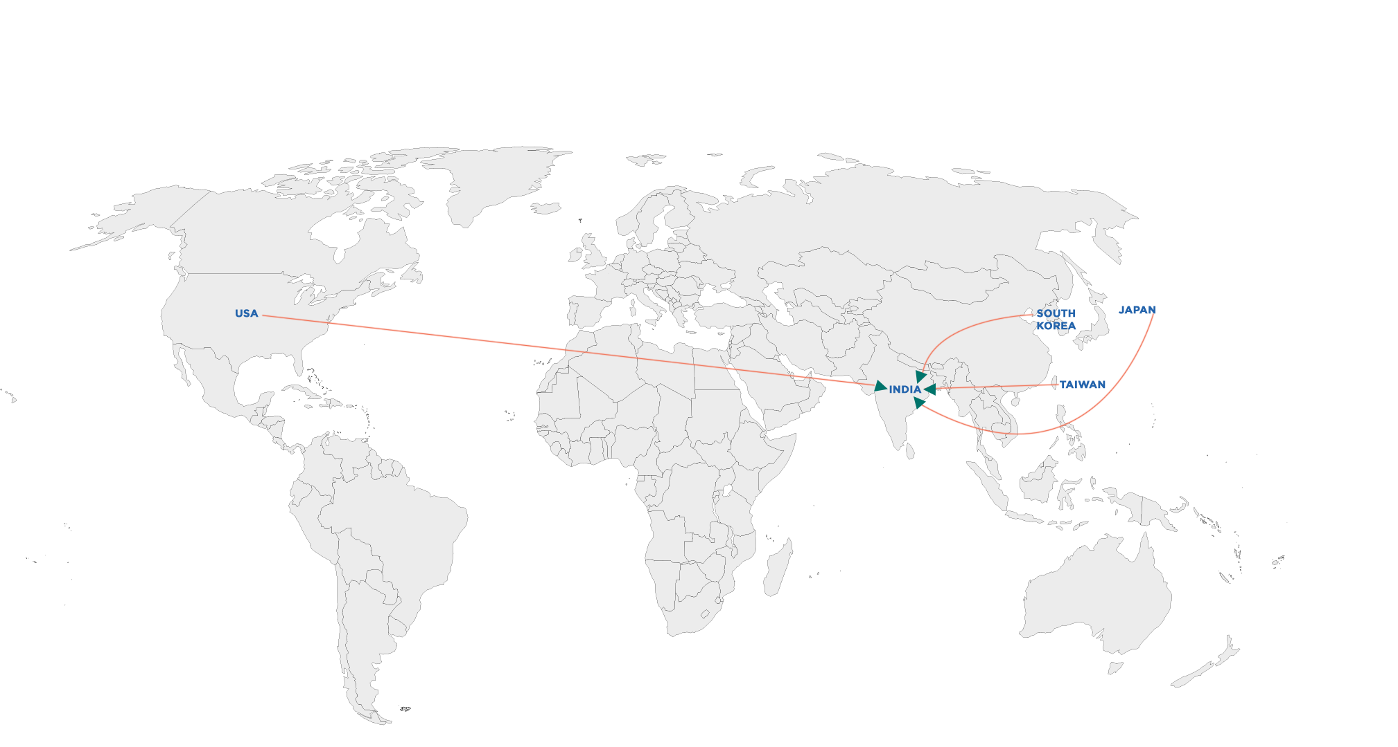
India: Imports, Exports (Opportunity)
India Trade Imports PVC:2021
India is significantly (55%) imports dependent
India is the largest importer of PVC with 1.6 million tonnes of imports in 2020.
Domestic Capacity Utilization : 89%
Anti-dumping duties imposed on imports from China PR and USA withdrawn in Feb 2022
Significant Exports Opportunity in Nearby Countries
18% GST on PVC trade within the country
10% custom duty imposed on Import
PVC HS Code: 390410
Suspension Grade PVC HS Code: 39041020
Emulsion Grade PVC HS Code: 39041010
Countries | 2020 |  | Net Export Potential
Countries | Import | Export | Net Export Potential
Bangladesh | 290.10 | 0 | 290.10
Malaysia | 169.66 | 47.62 | 122.04
Myanmar | 59.27 | 0 | 59.27
Sri Lanka | 45.9 | 0 | 45.9
Singapore | 36.87 | 2.35 | 34.52
Nepal | 6.99 | 0 | 6.99
Total Export Potential |  |  | 558.82
000’ Tonnes
Note: - The Import data is calculated for 2020 (calendar year from January 2020 to December 2020), India Import data vary as Import Export were taken from DGFT for Financial Year where FY 2021 means (April 2020 to March 2021).
PVC
Source: Department of Commerce, Ministry of Commerce and Industry, Government of India

Slide 10
India: Pricing (Average) Trend
India PVC Suspension Ex- Mumbai Yearly Prices (FY 2013- FY 2021), USD/MT
Upward price trend is observed from 2020 Onwards
PVC price is primarily dependent on the fluctuating price of Ethylene/EDC/VCM
Factors impacting prices of PVC in India
Increase in demand from construction sector.
Import shortage and persistent hike in shipping charges across several trade routes along southeast Asia.
Persistent hike in shipping charges across several trade routes along Southeast Asia
Rise in demand from the agriculture sector in forthcoming crop season.
Revision in domestic price of PVC across the country, can impact downstream users negatively, as it may squeeze their margin.
PVC
Source: TechSci Research

Slide 11
Global: Capacity, Production
Global Polyvinyl Chloride (PVC) Capacity and Production, By Volume (000’ Tonnes), 2015 - 2030F
Global Capacity by Company, By Volume- ((000’ tonnes)
Location | Companies | 2015 | 2020 | 2021E | 2022F | 2025F | 2030F
USA | Shin-Etsu, Formosa Plastics, Westlake, Occidental Petroleum, OxyVinyls, Georgia Gulf Corp | 9837 | 10157 | 10157 | 10157 | 10678 | 10678
China | Xinjiang Tianye Chemical, Xinjiang Huatai Heavy Chemical, Sinopec Qilu Petrochemical, Yibin Haifing Herui, Hanwha Chemical, Tianjin Dagu Chemical | 3560 | 3560 | 3560 | 3560 | 3560 | 3560
Germany | INOVYN, Vinnolit, VYNOVA | 1450 | 1450 | 1450 | 1450 | 1450 | 1450
France | INOVYN, Kem One, VYNOVA | 1445 | 1445 | 1445 | 1445 | 1445 | 1445
South Korea | LG Chem, Hanwha Chemical | 1380 | 1380 | 1380 | 1380 | 1380 | 1380
Others | Other Companies | 36168 | 36968 | 36968 | 37568 | 37878 | 37878
Total |  | 53840 | 54960 | 54960 | 55560 | 56391 | 56391
India contributes ~3% of the global PVC capacity with 1,553 thousand tonnes of capacity in FY 2020
Asia Pacific is the largest demand generating region and holds around 40% of global capacity
Shintech, Formosa Plastics, INOVYN, Occidental Petroleum, Westlake are top 5 PVC manufacturing companies globally (22% Capacity )
Rising demand for PVC in construction sector is anticipated to push the global demand for PVC
PVC
Source: TechSci Research

Slide 12
Global: Demand
Global Polyvinyl Chloride (PVC) Demand, By Volume (000’ Tonnes), 2015-2030F
Global Polyvinyl Chloride Demand Supply Gap 2010-2040F (000’ Tonnes)
Parameters | 2010 | 2015 | 2020 | 2021E | 2025F | 2030F | 2040F
Capacity | 46604 | 53,840 | 54,960 | 54,960 | 56,381 | 56,381 | 56,381
Production | 33840 | 40,987 | 43,090 | 43,965 | 47,482 | 48,358 | 50,445
Demand | 33840 | 40,987 | 43,090 | 44909 | 51,633 | 60,177 | 80,097
Y-O-Y Growth Rate, % | - | - | -5.93% | 4.22% | 3.21% | 3.05% | 2.71%
Demand-Supply Gap | - | - | - | -943 | -4,150 | -9,732 | -29,652
CAGR 2015-2020 | CAGR 2021E-2030F
1.01% | 3.31%
Global Polyvinyl Chloride (PVC) Demand, By End Use, By Volume (000’ Tonnes), 2015–2030F
India contributes ~8% of the PVC global demand at 3,501 thousand (FY2020)
India contributes to ~14% of the Global PVC pipes & fittings market demand (FY2020)
Vinnolit K GmbH / Krupp Uhde , Solvay Technology Solutions, Chisso, INEOS Technologies, The Geon Co., Vestolit GmbH / Hulls AG, and Hanwha are key technology providers for PVC for both grades (suspension and emulsion)
Total | 40,987 | 43,090 | 44,908 | 46,635 | 51,632 | 60,177
PVC
Source: TechSci Research

Slide 13
Global: Demand
Region | Factors Impacting Demand
Asia-Pacific | Growing construction, healthcare, and packaging sector Initiatives and construction projects such as China Belt and Road Initiative, construction of new airports, and roads, “Housing for All’, “Smart Cities Project”, Industrial Corridor Project, “Make in India”. Increased manufacturing of blood and urine bags and other medical equipment as well during Covid-19.
North America | Construction and commercial activities High exports from USA. It is the largest PVC exporting country Increased industrial construction activities owing to shifting of manufacturing units back to USA Hindrance in supply chain Expansion of new PVC and VCM manufacturing plants Shintech, subsidiary of Japan’s Shin-Etsu Chemical Co. has invested USD1.3 billion to expand its PVC manufacturing facilities at its Plaquemine, LA., site with an installed capacity of 380 thousand tonnes of PVC and 580 KTPA for the manufacturing of its precursor VCM. Formosa is scheduled to start a new 130 KTPA PVC production line at its Baton Rouge, LA plant in the 4th quarter 2022.
Europe | Growth in construction activities coupled with increase in demand from automotive sector Supply chain disruption Volatile prices due to shortage of supply of PVC Increasing demand for pipes, profiles, insulating materials
MEA and South America | Multiple large scale infrastructure projects in MEA Increasing usage of PVC pipes, cables and window profiles in housing, building and other infrastructural developments. Heavy investment in downstream sector in South America
Global Polyvinyl Chloride (PVC) Demand, By Region, By Volume (000’ Tonnes), 2015–2030F
Total | 40,987 | 43,090 | 44,908 | 46,635 | 51,632 | 60,177
“Atmanirbhar Bharat” and “Make in India” policies are driving the domestic production
PVC
Source: TechSci Research

Slide 14

Financial Analysis: Plant Set-up
PVC

Slide 15
Plant Set-up: Capex
Option:1
Option:2
Option:3
Total Fixed Capital Investment: INR 4,058 Crore
Total Fixed Capital Investment: INR 4,443 Crore
Total Fixed Capital Investment: INR 2,415 Crore
Total Capital Investment: INR 4,159 Crore
Total Capital Investment: INR 6,053 Crore
Total Capital Investment: INR 4,428 Crore
350 KTPA PVC + Captive Ethylene
500 KTPA PVC (350 KTPA (captive ethylene)+150 KTPA(EDC / VCM Outsourced)
500 KTPA EDC / VCM to PVC, EDC / VCM Outsourced
PVC

Slide 16
Plant Set-up: Opex
Option:1
Option:2
Option:3
Total Production Cost INR 1,256 Crore
Total Production Cost : INR 1,937 Crore
Total Production Cost : INR 2,877 Crore
Total Variable Cost: INR 1,082 Crore
Total Variable Cost: INR 1,686 Crore
Total Variable Cost: INR 2,673 Crore
Others include Variable and Selling Overheads
350 KTPA PVC + Captive Ethylene
500 KTPA PVC (350 KTPA (Captive Ethylene)+150 KTPA(EDC / VCM Outsourced)
500 KTPA EDC / VCM to PVC, EDC / VCM Outsourced
PVC

Slide 17
Plant Set-up: Operating Revenue, Operating Cost, Gross Margin
Operating Revenue
Note: All figures are in INR Crores
Option 1:Lower operating revenue because of lower capacity
Option 2 & 3 : Same operating revenue because both has the same capacity
Operating Cost
Note: All figures are in INR Crores
Option 1 :Inhouse production of feedstock offers an advantage of lowest operating cost
Option 2 & 3 :Higher operating cost because of higher capacity and EDC/VCM outsourcing.
Gross Margin
Note: All figures are in INR Crores
Gross Margins in option 1 and 2 are improved in comparison to 3, because of the spread between PVC and EDC / VCM.
Source: TechSci Research
350 KTPA PVC + Captive Ethylene
500 KTPA PVC (350 KTPA (Captive Ethylene)+150 KTPA(EDC / VCM Outsourced)
500 KTPA EDC / VCM to PVC, EDC / VCM Outsourced
PVC

Slide 18
Plant Set-up: Summary
All values are in INR Crores
Project Sensitivity Analysis | Project Sensitivity Analysis
S.No. | Project Sensitivity | Profit After Tax
 |  | Option-1
 | Profit After Tax (at optimum capacity utilization) | Nil
1 | Selling Price decreases by 11%, Raw Material Price remains same | 20% decrease
2 | Increase in Raw Material price by 16.5 % with no change in selling price | 14% decrease
3 | Increase in raw material price by 9 % with decrease in selling price by 5% | 20% decrease
4 | Increase in Cost of Production by 14.5% with no change in selling price | 18% decrease
350 KTPA PVC + Captive Ethylene
500 KTPA PVC (350 KTPA (Captive Ethylene)+150 KTPA(EDC / VCM Outsourced)
500 KTPA EDC / VCM to PVC, EDC / VCM Outsourced
PVC
Source: TechSci Research

Slide 19
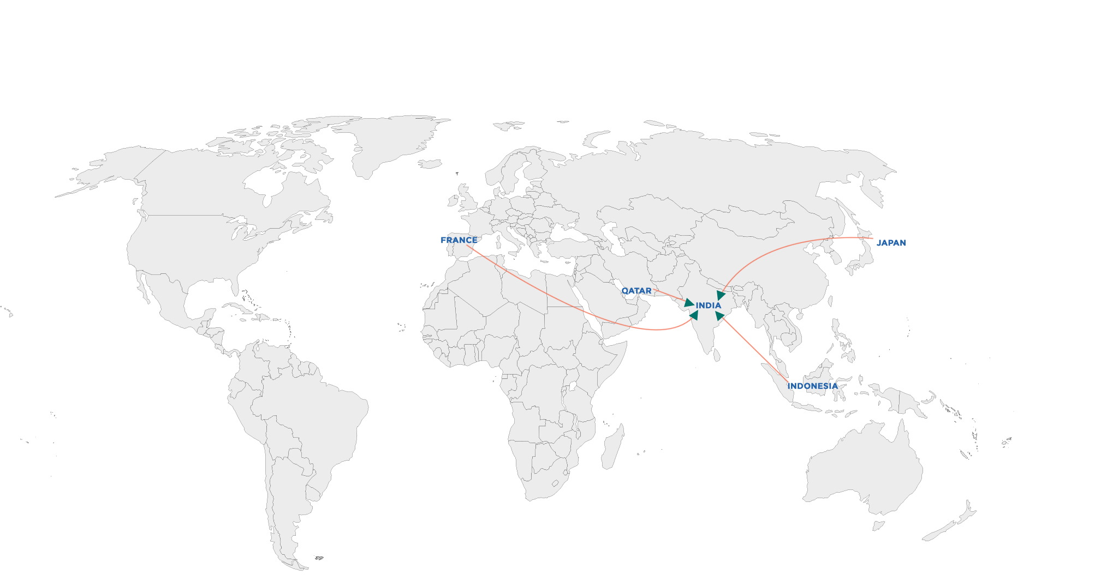
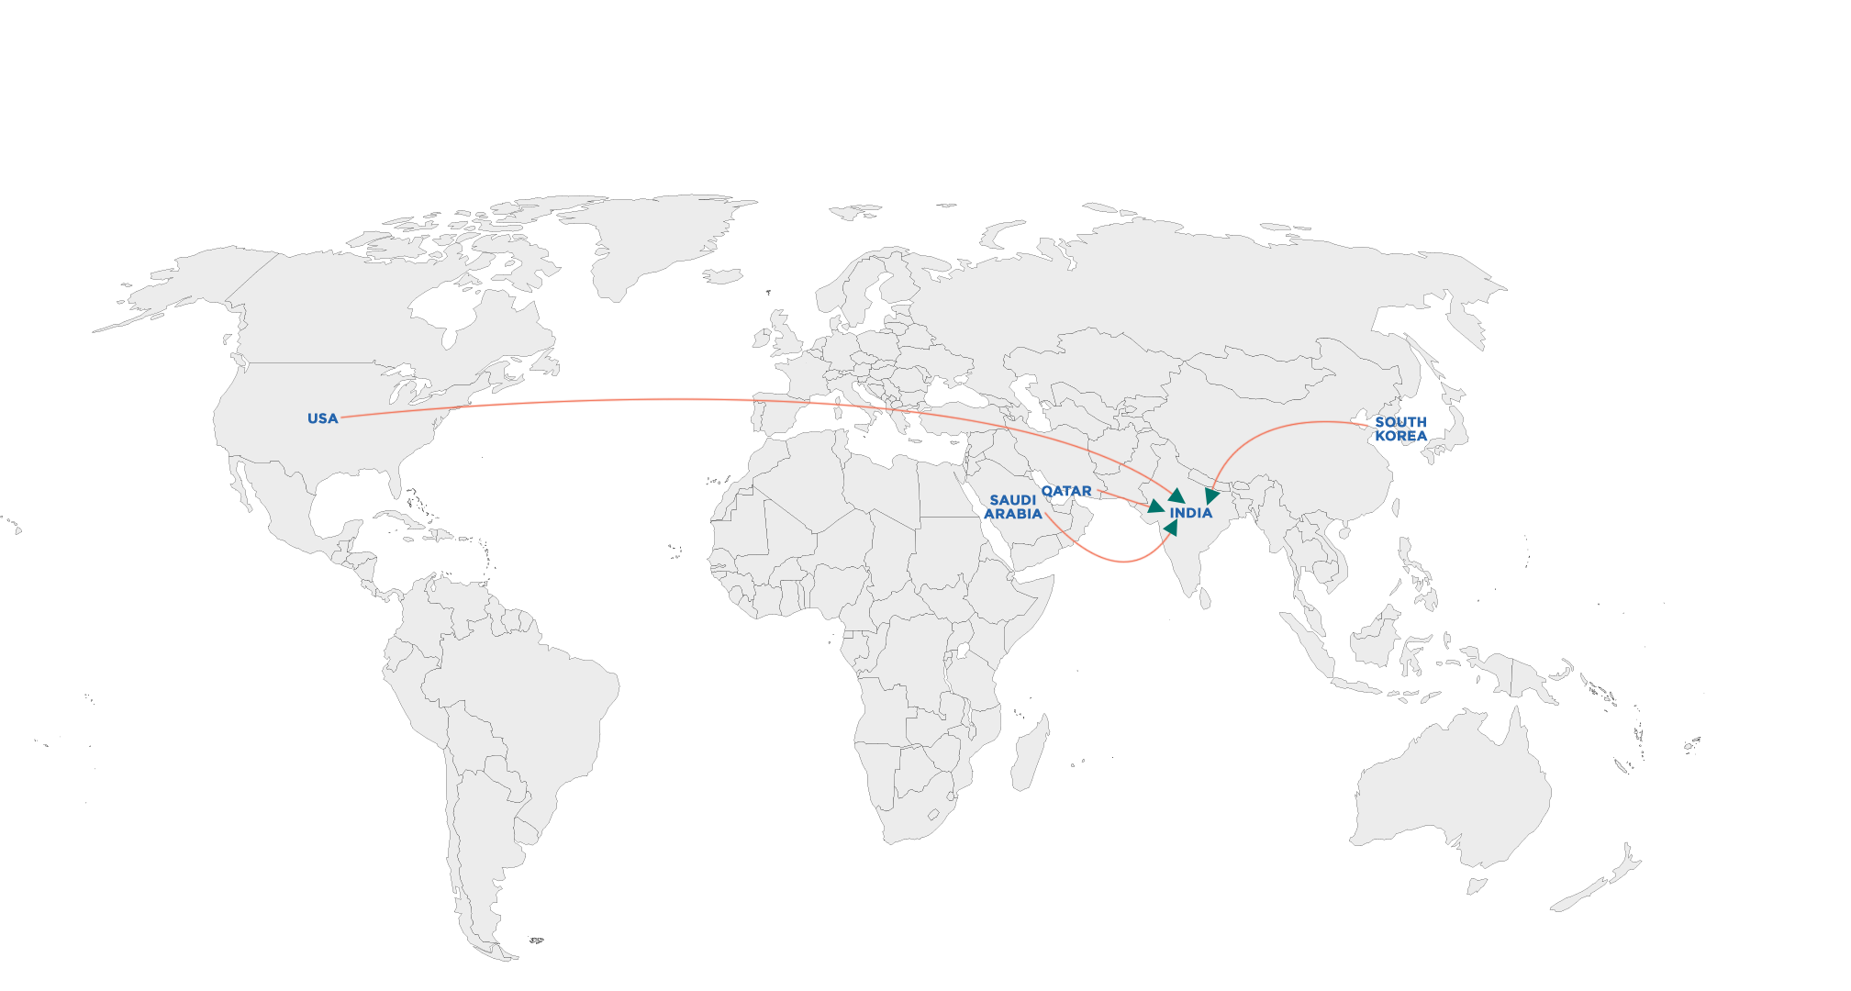
Plant Set-up: Raw Material Availability—Relevant To Option 2 and Option 3
India Trade Import Details of VCM (2020), (000’ Tonnes)
India Trade Import Details of EDC (2020), (000’ Tonnes)
India Net VCM Import: 461 (000’ Tonnes)
India Net EDC Import: 725 (000’ Tonnes)
EDC/VCM is primarily used to manufacture PVC Resin
VCM and EDC have to be sourced from Imports : Option 2 and Option 3
EDC (Captive Production in India): Reliance
VCM (Captive Production in India): Reliance, Finolex, Chemplast, DCW
Northeast Asia held the largest share: Production and consumption
Option 2: 500 KTPA PVC (350 KTPA from captive ethylene and 150 KTPA Through EDC / VCM Outsourced)
Option 3: 500 KTPA EDC / VCM to PVC, EDC / VCM Outsourced
000’ Tonnes
000’ Tonnes
Note: - The Import data is calculated for 2020 (calendar year from January 2020 to December 2020), India Import data vary as Import Export were taken from DGFT for Financial Year where FY 2021 means (April 2020 to March 2021).
PVC
Source: Department of Commerce, Ministry of Commerce and Industry, Government of India

Slide 20

Recommendations & Conclusions
PVC

Slide 21
Conclusions & Recommendations: Market Opportunity
All manufactures offer suspension grade
Finolex Industries Limited & Chemplast Sanmar Limited also offer emulsion grade
PVC price is primarily dependent on the fluctuating price of Ethylene / EDC/VCM
Overall, the PVC market will be more than approximately three times from 2870 Thousand MT in 2021 to 10,802 Thousand MT in 2040
Suspension Grade will always be the most prominent type :95% Demand
Pipes & Fittings will always be the most prominent end-use :73% Demand
Rigid PVC will always be is the most prominent type :85% Demand
West India+ South India will Continue to be the largest region: 70% Demand
Domestic Capacity Utilization: 89%
India is significantly (55%) imports dependent
Significant Exports Opportunity in Nearby Countries
Upcoming Greenfield / Brownfield Projects will intensity the competition
RIL—significant competitor: dedicated plants in Hazira. Vadodara. Also, expansion plans.
RIL Dahej unit is planning to add 1000 KTPA capacity in near vicinity which may result in oversupply condition in western region acting as a threat for OPaL.
Demand-Supply Gap (1733 KT in 2022 to 6752 KT in 2040) arguments the need for new player , even post-realization of ongoing/ upcoming Greenfield/ Brownfield Projects
Strategic location plays a vital role for OPaL, as the availability of chlorine is a significant challenge for players operating in the market. Therefore, OPaL can go for a long-term contract with caustic soda players operating in the region for the availability of chlorine. Gujarat Alkalies and Chemicals Limited, Meghmani Organics Limited and DCM Shriram Consolidated Limited are the leading players in the region.
Vinnolit K GmbH / Krupp Uhde (Low Cost of Production) , INEOS Technologies( Higher Yield), and Hanwha (All Grades) are recommended Technology Licensors
A substantial business opportunity exists, but there would always be a threat of new players entering the market, specifically those companies with the advantage of in-house Ethylene. The early entrant will influence the entry plans of possible another entrant.
OPAL can utilize a fully integrated unit to advantage as it has captive ethylene.
PVC

Slide 22
Conclusions & Recommendations: Most Suitable Plant Set-up Option
Features | Option 1 | Option 2 | Option 3
CapEx (INR Crore) | 4159 | 6053 | 4427
OpEx (INR Crore) | 1256 | 1938 | 2877
NPV (INR Crore) | 12735 | 15080 | 6440
IRR | 19.40% | 16.96% | 11.95%
Payback Period (Years) Simple | 3.32 | 3.77 | 5.05
Propane (Raw material & Feed) | Propane through Parent Company ONGC | Propane through Parent Company ONGC | Not required
EDC/ VCM (Raw material & Feed) | Not Required | Required through Imports: 150KTPA | Required through Imports 500 KTPA
Chlorine Sourcing | Chlor-Alkali units (DCM Sriram, Meghmani, GACL) in proximity | Chlor-Alkali units (DCM Sriram, Meghmani, GACL) in proximity | Not Required
Jetty Facility | Not Required | Required | Required
Margin %(Starting from First Year of Operation | 48.59% | 40.04% | 19.02%
350 KTPA PVC + Captive Ethylene
500 KTPA PVC (350 KTPA (captive ethylene)+150 KTPA(EDC / VCM Outsourced)
500 KTPA EDC / VCM to PVC, EDC / VCM Outsourced
Preference Option Rank:
1
2
3
OPaL will have sufficient ethylene, propylene and benzene after commissioning the propane furnace. Therefore, Option 1 will have better NPV, IRR, Payback Period and margin despite having the highest CapEx
The Option1 is most feasible in terms of execution and realization as it won’t require EDC/VCM sourcing from the international market. The jetty facility will also be not needed.
PVC

Slide 23
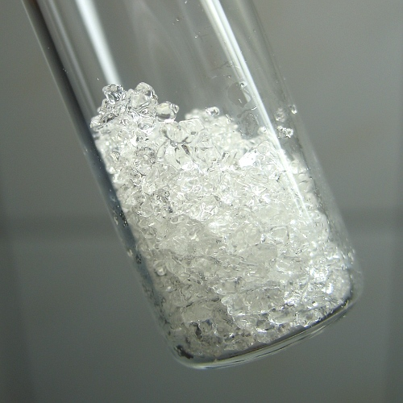
Phenol

Slide 24
India: Manufacturing Landscape
India Phenol Capacity, By Company (000’ Tonnes)
West
Company | Technology Provider | Capacity, FY2021
Deepak Phenolics Ltd. | Kellogg Brown & Root International Inc. (KBR) (For Phenol and Acetone) Honeywell UOP LLC (Cumene) | 200
Hindustan Organic Chemicals Ltd. | Honeywell UOP LLC | 42
SI Group India Ltd. | Honeywell UOP LLC | 37
Dahej, Deepak Phenolics
Navi Mumbai, SI Group India
1
2
Deepak Phenolics has capacity of Cumene (captive consumption)
Deepak Phenolics has integrated unit to produce IPA from Acetone
South
1
Kochi, Hindustan Organic Chemicals Ltd.
Phenol
Source: TechSci Research

Slide 25
India: Capacity, Production, Demand
India Phenol Capacity and Production, By Volume (000’ Tonnes), 2010 - 2040F
India Phenol Demand Supply Scenario, 2010-2040F (000 Tonnes)
Parameters | 2010 | 2015 | 2021 | 2022E | 2025F | 2030F | 2035F | 2040F
Capacity | 79.00 | 79.00 | 279.00 | 279.00 | 279.00 | 279.00 | 279.00 | 279.00
Production | 71.82 | 42.12 | 246.90 | 250.70 | 257.35 | 271.05 | 273.42 | 273.42
Import | 112.40 | 199.68 | 170.62 | 148.73
Export | 0.40 | 1.50 | 51.05 | 44.65
Inventory | 4.50 | 3.12 | 4.94 | 2.56
Demand | 179.00 | 237.00 | 362.00 | 352.00 | 429.00 | 584.00 | 811.00 | 1136.00
Y-O-Y Growth Rate, % |  | 2.99% | 9.91% | -2.58% | 6.50% | 6.80% | 6.90% | 7.01%
Demand - Supply Gap |  |  |  | -102 | -171 | -313 | -537 | -863
India Acetone Demand Supply Scenario, 2010-2040F (000 Tonnes)
Parameters | 2010 | 2015 | 2021 | 2022E | 2025F | 2030F | 2035F | 2040F
Capacity | 45.00 | 45.00 | 169.00 | 169.00 | 169.00 | 169.00 | 169.00 | 169.00
Production | 44.00 | 26.00 | 149.00 | 152.00 | 155.00 | 164.00 | 165.00 | 165.00
Import | 80.00 | 127.00 | 82.00 | 101.00 | -
Export | 0.50 | 3.18 | 28.16 | 34.00
Inventory | 0.89 | 0.52 | 2.99 | 3.03
Demand | 123.00 | 149.00 | 200.00 | 216.00 | 262.00 | 358.00 | 474.00 | 605.00
Y-O-Y Growth Rate, % | - | 3.49% | 3.18% | 8.05% | 6.22% | 6.88% | 5.52% | 4.71%
Demand - Supply Gap |  |  |  | -65 | -106 | -194 | -309 | -440
Significant Imports: 42% Demand
Demand-Supply Gap arguments the need of a new player . No explanation /New plant announced, as of now.
Downstream integration opportunities exist to produce chemical like Bisphenol A, Isopropyl Alcohol, Ketoxime etc.
Well Established technology and production of cumene as intermediate and Acetone as by product add to volume and additional revenues in this segment.
Phenol
Source: TechSci Research

Slide 26
India: Demand—Phenol
India Phenol Demand, By Volume (000’ Tonnes), 2010-2040F
CAGR 2010-2021 | CAGR 2022E-2030F | CAGR 2031F-2040F
6.58% | 6.54% | 6.91%
Major players are Deepak Phenolics Ltd, Hindustan Organic Chemicals Ltd. and SI Group India Ltd.
India Phenol Demand, By End Use, By Volume (000’ Tonnes), FY 2010– FY 2040F
Phenol Formaldehyde resin accounts to nearly 70% of the total demand in India
Phenol Formaldehyde Resin is the most prominent end-use
Growing demand of Bisphenol- A is one of the major drivers
Honeywell UOP, The Kellogg Brown & Root (KBR) Technology, Lummus Phenol Technology, Badger Acetone -to- Cumene (ATC) Technology are the major technology providers for Phenol and Acetone manufacturing
Total | 179 | 237 | 329 | 362 | 352 | 429 | 584 | 811 | 1136
Phenol
Others include Caprolactam, Aniline, Cyclohexanone, etc
Source: TechSci Research

Slide 27
India: Demand—Phenol
India Phenol Demand, By Region, By Volume (000’ Tonnes), FY 2010– FY 2040F
West India is the largest region
West
Dahej, Deepak Phenolics
Navi Mumbai, SI Group India
1
2
Total | 179 | 237 | 329 | 362 | 352 | 429 | 584 | 811 | 1136
West India+South India: ~83% of the total demand
End-Use Sectors : Pharmaceuticals and construction
South
Kochi, Hindustan Organic Chemicals Ltd.
1
Phenol
Source: TechSci Research

Slide 28
India: Demand—Acetone
India Acetone Demand, By Market Share, By Region, FY2021 & FY2040 (%)
North
West India is the largest region
India Acetone Demand, By Market Share, By Region, FY2021 (%)
South India is second largest because of growing Pharmaceuticals industry and Production Linked Incentive (PLI) scheme to encourage the pharmaceutical industry growth.
West India+South India: ~80% of the total demand
West
India Acetone Demand, By Market Share, By Region, FY2040 (%)
East
India Acetone Demand, By End Use, By Volume (000’ Tonnes), FY 2021, FY 2040F
End Use | FY 2021 | FY 2040
Pharmaceuticals & Solvent | 61.46% | 55.23%
Bisphenol-A (BPA) | 12.04% | 16.83%
Methyl Methacrylate (MMA) | 11.55% | 10.48%
Methyl Isobutyl Ketone (MIBK) | 10.10% | 11.59%
Others | 4.85% | 5.87%
South
Phenol
Source: TechSci Research

Slide 29
India: Trade, Exports (Opportunity)
Significant Exports Opportunity in Nearby Countries
Export Potential Market of Phenol
India may be a significant exporter of Phenol and Acetone. OPaL can replicate the exports business model of Deepak Phenolics (Only Exporter) and, in the proximity of OPaL
Countries | 2020
 | Import | Export | Net Export Potential
China | 709.92 | 17.29 | 692.63
Taiwan | 105.56 | 180.52 | -74.96
Thailand | 40.08 | 225.11 | -185.03
Malaysia | 22.73 | 0.25 | 22.48
Indonesia | 17.14 | 0.27 | 16.87
Antidumping duty levied on imports of Phenol from Thailand and USA
18% GST on Phenol traded within the country
Note: Import and export volumes are in thousand tonnes
7.5% custom duty imposed on Import
Present Scenario of Anti-Dumping Duty (ADD)
Countries | Quantum of Duty imposed | Remarks
USA | USD 250 per MT - USD 350 per MT
Thailand | USD 250 per MT - USD 350 per MT
South Korea | US$ Nil to 253.06 per MT | Removed effective from 31/10/2021
European Union | US$ Nil to 253.06 per MT | Removed effective from 31/10/2021
Singapore | US$ Nil to 253.06 per MT | Removed effective from 31/10/2021
10% social welfare surcharge on Phenol
Phenol HS Code: 29071110
Phenol
Source: - Department of Commerce, Ministry of Commerce and Industry, Government of India, UN Comtrade

Slide 30
India: Pricing (Average) Trend
India Phenol & Acetone Historical prices (FY 2013-FY 2022) (USD/MT)
Upward price trend is observed from 2021 onwards
Phenol price is primarily dependent on the fluctuating price of Propylene, Benzene and Cumene
Acetone price is driven by market conditions and production of phenol
Phenol
Source: TechSci Research

Slide 31
Global: Capacity, Production
Global Phenol Capacity and Production, By Volume (000’ Tonnes), 2010 - 2040F
India contributes ~2% of the global phenol capacity in FY2020
INEOS Group, Cepsa Corporation, Kumho Chemicals, LG Chem are the leading global producers of Phenol.
Ineos group operates phenol and acetone plants at sites in Gladbeck, Germany; Antwerp, Belgium; and Mobile, Alabama in the United States. All three sites use their own proprietary technology.
In Europe, the major competitors for Ineos group are Cepsa, Novapex, Borealis and Versalis.
In North America, major competitors are Shell and Honeywell.
Has consumers globally, including Covestro (previously Bayer), Olin (previously Dow), Sabic, Fibrant (previously DSM), Evonik and Lucite.
Phenol
Source: TechSci Research

Slide 32
Global: Capacity, Production
Capacity by Location, 000’ Tonnes
Location | Companies | 2010 | 2015 | 2021E | 2022F | 2025F | 2030F | 2035F | 2040F
USA | Ineos Group Ltd, Advansix, Shell Chemicals, SABIC Innovative Plastics, Altivia Petrochemicals, Olin Corporation, Georgia Gulf Corporation | 2422 | 2422 | 2572 | 2572 | 2882 | 2882 | 2882 | 2882
China | Ineos Group Ltd, Cepsa Corporation, Zhejiang Rongsheng, Chang Chun Chemical, Shanghai Sinopec Mitsui, CNOOC Huizhou | 250 | 800 | 1820 | 1820 | 1820 | 1820 | 1820 | 1820
South Korea | Kumho P&B Chemicals., Inc., LG Chem | 980 | 980 | 1280 | 1280 | 1280 | 1280 | 1280 | 1280
Taiwan | Formosa Chemical and Fibre, Taiwan Prosperity Chemical Corp., Chang Chun Plastic | 960 | 960 | 960 | 960 | 1060 | 960 | 960 | 960
Belgium | Ineos Group Ltd | 680 | 680 | 680 | 680 | 680 | 680 | 680 | 680
Others |  | 4158 | 4381 | 5211 | 5211 | 5801 | 6151 | 6151 | 6151
Total |  | 9450 | 10223 | 12523 | 12523 | 13523 | 13773 | 13773 | 13773
Major Expansions for the Manufacturing of Cumene, Phenol and Acetone, By Location
Company | Licensor | Product | Capacity (000’ Tonne) | Location | Likely Year of Commissioning
Formosa Chemicals and Fibre Corp | Lummus Technology | Cumene, Phenol & Acetone | 400 | Nimbo, China | 2025
PKN Orlen | UOP’s Q-Max | Cumene, Phenol & Acetone | 200 | Plock, Poland | 2024
PKN Orlen | Badger | Acetone and Isopropanol | 140 | Plock, Poland | 2024
Reliance Industries Ltd | NA | Cumene, Phenol & Acetone | 200 | Jamnagar, Gujarat | Planning Stage Only
Ineos Group | Ineos | Cumene | 750 | Marl, Germany | 2022
Haiwan Chemical | KBR | Cumene, Phenol & Acetone | 320 | Shandong, China | 2024
Phenol
Source: TechSci Research

Slide 33
Global: Demand- Phenol
Global Phenol Demand, By Volume (000’ Tonnes), 2010-2040F
India contributes~3% of the global phenol market demand (FY2020)
Growth in construction, automotive and infrastructure sectors supports phenol demand
CAGR 2010-2021 | CAGR 2022E-2030F | CAGR 2031F-2040F
3.1% | 3.9% | 3.0%
Global Phenol Demand Supply Scenario, 2010-2040F, (000 Tonnes)
Parameters | 2010 | 2015 | 2021E | 2022F | 2025F | 2030F | 2035F | 2040F
Capacity | 10,223.00 | 10,223.00 | 12,523.00 | 12,523.00 | 13,523.00 | 13,773.00 | 13,773.00 | 13,773.00
Production | 7,956.00 | 8,408.00 | 10,865.00 | 11,007.00 | 11,916.00 | 12,665.00 | 12,757.00 | 12,757.00
Demand | 7,956.24 | 8,407.84 | 10,828.50 | 11,267.00 | 12,697.00 | 15,258.20 | 17,819.20 | 20,527.31
Y-O-Y Growth Rate, % |  | 4.99% | 6.22% | 4.05% | 3.82% | 3.39% | 3.36% | 2.80%
Demand - Supply Gap |  |  | 36.00 | -260.00 | -781.00 | -2,593.00 | -5,062.00 | -7,770.00
Phenol
Source: TechSci Research

Slide 34
Global: Demand- Phenol
Global Phenol Demand, By End Use, By Volume (000’ Tonnes), 2010–2040F
Bisphenol-A is the most prominent end-use
India contributes~1% of the global BPA market demand (FY2020)
Manufacturing of polycarbonate and epoxy resin is expected to drive the Bisphenol A (BPA) demand
Epoxy resins are used manufacturing in adhesives, fillings, and composite materials.
Total | 7956.24 | 8407.84 | 10194.37 | 10828.46 | 11267.01 | 12696.97 | 15258.16 | 17819.23 | 20527.31
Global Phenol Demand, By Region, By Volume (000’ Tonnes), 2010–2040F
Asia-Pacific is the most prominent region
India contributes ~6% of the APAC phenol market demand in FY2020
Phenolic Resin is the largest derivative in the APAC region, holding approximately 41% of total consumption
Phenolic resins are widely used as a binding and insulating material
Phenol
Total | 7956.24 | 8407.84 | 10194.37 | 10828.46 | 11267.01 | 12696.97 | 15258.16 | 17819.23 | 20527.31
Source: TechSci Research

Slide 35
Global: Demand- Acetone
Global Acetone Demand, By Volume (000’ Tonnes), 2010-2040F
India contributes~2% of the global acetone market demand (FY2020)
Growth in pharmaceutical, automotive and solvent based products like thinners supports phenol demand
CAGR 2010-2021 | CAGR 2022E-2030F | CAGR 2031F-2040F
4.6% | 5.4% | 4.4%
Global Acetone Demand Supply Scenario, 2010-2040F, (000’ Tonnes)
Parameters | 2010 | 2015 | 2021E | 2022F | 2025F | 2030F | 2035F | 2040F
Capacity | 5084.4 | 6265.8 | 7513.8 | 7513.8 | 8113.8 | 8263.8 | 8263.8 | 8263.8
Production | 4973.9 | 5872.7 | 7790.2 | 8175.5 | 9256.8 | 11248.4 | 13516.8 | 16083.9
Demand | 4973.9 | 5872.7 | 8134.9 | 8587.2 | 10176.5 | 13094.7 | 16563.4 | 20235.0
Y-O-Y Growth Rate, % |  | 4.64% | 6.12% | 5.56% | 5.94% | 4.94% | 4.72% | 3.72%
Demand - Supply Gap |  |  | -344.7 | -411.8 | -919.7 | -1846.3 | -3046.6 | -4151.1
Phenol
Source: TechSci Research

Slide 36
Global: Demand- Acetone
Global Acetone Demand, By End Use, By Volume (000’ Tonnes), 2021 & 2040F
Pharmaceuticals & Solvent is the most prominent end-use
End Use | 2021 | 2040
Pharmaceuticals & Solvent | 40.61% | 42.03%
Bisphenol-A (BPA) | 24.85% | 22.13%
Methyl Methacrylate (MMA) | 14.63% | 16.15%
Methyl Isobutyl Ketone (MIBK) | 12.71% | 11.43%
Others | 7.20% | 8.26%
China contributes~18% of the global acetone market demand (FY2020)
Manufacturing of Bisphenol-A and IPA will drive the future demand
Global Acetone Demand, By Region, By Volume (000’ Tonnes), 2010–2040F
Asia-Pacific is the most prominent region
India contributes ~5% of the APAC acetone market demand in FY2022
In China and India, Acetone is used for the manufacturing of vitamins API and antibiotics (cephalosporins).
Phenol
Total | 4973.9 | 5872.7 | 7665.8 | 8134.9 | 8587.2 | 10176.5 | 13094.7 | 16563.4 | 20235.0
Source: TechSci Research

Slide 37
Financial Analysis: Plant Set-up
Phenol

Slide 38
Plant Set-up: Capex
Option-1
Option:2
Option:3
Total Fixed Capital Investment: INR 1,568Crore
Total Fixed Capital Investment: INR 1,392 Crore
Total Fixed Capital Investment: INR 1,671 Crore
Total Capital Investment: INR 1,769 Crore
Total Capital Investment: INR 1,549 Crore
Total Capital Investment: INR 1,937 Crore
200 KTPA Phenol+120 KTPA Acetone (Propane Furnace Additional)
200 KTPA Phenol + 120 KTPA Acetone, (Propylene : 80 % In-house+ 20 % external)
200 KTPA Phenol + 120 KTPA Acetone, (with available propylene and benzene)
Phenol

Slide 39
Plant Set-up: Opex
Option:1
Option:2
Option:3
Total Production Cost : INR 1, 681 Crore
Total Production Cost : INR 1,360 Crore
Total Production Cost : INR 1,756 Crore
Total Variable Cost: INR 1,674 Crore
Total Variable Cost: INR 1,308 Crore
Total Variable Cost: INR 1,630 Crore
Others include Variable and Selling Overheads
200 KTPA Phenol+120 KTPA Acetone (Propane Furnace Additional)
200 KTPA Phenol + 120 KTPA Acetone, (Propylene : 80 % In-house+ 20 % external)
Phenol
200 KTPA Phenol + 120 KTPA Acetone, (with available propylene and benzene)

Slide 40
Plant Set-up: Operating Revenue, Operating Cost, Gross Margin
Operating Revenue
Note: All figures are in INR Crores
Option 1 & 3: Same operating revenue because of the production of same quantity of phenol and acetone.
Option 2 : Lower operating revenue because of 20% lesser production
Operating Cost
Note: All figures are in INR Crores
Option 2 :Lower operating cost because of lower intermediates production.
Option 1 : Higher operating cost because of higher utilization of raw materials.
Gross Margin
Note: All figures are in INR Crores
Option 3 : Gross margin higher due to lower fixed and variable cost as it require 20 percent external sourcing of propylene (refinery and chemical grade).
Source: TechSci Research
200 KTPA Phenol+120 KTPA Acetone (Propane Furnace Additional)
200 KTPA Phenol + 120 KTPA Acetone, (Propylene : 80 % In-house+ 20 % external)
200 KTPA Phenol + 120 KTPA Acetone, (with available propylene and benzene)
Phenol

Slide 41
Plant Set-up: Summary
All values are in INR Crores
Project Sensitivity Analysis | Project Sensitivity Analysis
S.No. | Project Sensitivity | Profit After Tax
 |  | Option-1
 | Profit After Tax (at optimum capacity utilization) | Nil
1 | Selling Price decreases by 11%, Raw Material Price remains same | 56% decrease
2 | Increase in Raw Material price by 16.5 % with no change in selling price | 50% decrease
3 | Increase in raw material price by 9 % with decrease in selling price by 5% | 52% decrease
4 | Increase in Cost of Production by 14.5% with no change in selling price | 54% decrease
200 KTPA Phenol+120 KTPA Acetone (Propane Furnace Additional)
200 KTPA Phenol + 120 KTPA Acetone, (Propylene : 80 % In-house+ 20 % external)
200 KTPA Phenol + 120 KTPA Acetone, (with available propylene and benzene)
Source: TechSci Research
Phenol

Slide 42
Recommendations & Conclusions
Phenol

Slide 43
Conclusions & Recommendations: Market Opportunity
Deepak Phenolics has integrated unit to produce IPA from Acetone
Deepak Phenolics and SI Group India has capacity of Cumene (captive consumption)
Phenol price is primarily dependent on the fluctuating price of Propylene, Benzene and Cumene
Overall, the Phenol market is expected to be more than approximately three times from 362 Thousand MT in 2021 to 1,136 Thousand MT in 2040
Phenol Formaldehyde Resin : 62% Demand
West India+ South India will Continue to be the largest region: 83% Demand (Phenol) . 80% Demand( Acetone)
Domestic Capacity Utilization : 88%
India is significantly (42%) imports dependent
Significant Exports Opportunity in Nearby Countries
Demand-Supply Gap (102 KT in 2022 to 862 KT in 2040) arguments the need for new player. No explanation /New plant announcement as of now
Downstream integration opportunities exist to produce chemical like Bisphenol A, Isopropyl Alcohol, Ketoxime etc.
Well Established technology and production of cumene as intermediate and Acetone as by product add to volume and additional revenues in this segment.
A substantial business opportunity exists, but there would always be a threat of new players entering the market, specifically those companies with the advantage of additional cumene capacity for captive consumption. The early entrant will influence the entry plans of possible another entrant.
Volatility in crude oil prices in the international market may result in increased costs of benzene and propylene (raw materials for Phenol).With the surplus supply of upstream products, the company can enter Phenol-based markets such as BPA, phenol-formaldehyde resins, and others & diversify its Product Portfolio..
West India is a strategic location to be tapped. Deepak Phenolics and SI Group India Ltd. already have a location advantage in the West. Indian producers are ramping up their production, and still, there is ample scope for setting up a new greenfield unit in West or South India.
Owing to the presence of various end-user industries and the marginal extent of the market penetration in the states such as Gujarat and Maharashtra, the west region dominates the Indian Acetone Market.
Phenol

Slide 44
Conclusions & Recommendations: Most Suitable Plant Set-up Option
Features | Option 1 | Option 2 | Option 3
CapEx (INR Crore) | 1769 | 1549 | 1937
OpEx (INR Crore) | 1681 | 1360 | 1756
NPV (INR Crore) | 6337 | 4781 | 5235
IRR | 21.20% | 19.22% | 17.63%
Payback Period (Years) Simple | 2.95 | 3.28 | 3.59
Propylene | Available through DFCU and Propane Furnace Addition | Up to 80% (DBN – 8500 Hrs. Operation) | External Procurement (Up to 20 Percent)
Benzene (Raw material & Feed) | Available through DFCU | Available through DFCU | Available through DFCU
Margin %(Starting from First Year of Operation | 25.52% | 24.66% | 22.25%
200 KTPA Phenol+120 KTPA Acetone (Propane Furnace Additional)
200 KTPA Phenol + 120 KTPA Acetone, (Propylene : 80 % In-house+ 20 % external)
200 KTPA Phenol + 120 KTPA Acetone, (with available propylene and benzene)
Preference Rank:
1
2
3
OPaL will have sufficient propylene after the commissioning of the propane furnace. Therefore, Option 1 will have better NPV, IRR, Payback Period and margin despite having the highest CapEx
Option 1 is most feasible in terms of execution and realization as it won’t require refinery and chemical-grade propylene sourcing from the international and domestic market.
Options 2 & 3 have significantly lower NPV, IRR, while CapEx is marginally higher due to the addition of a gantry storage system for handling propylene.
Phenol

Slide 45
PVC
Phenol

Slide 46
Plant Set-up Option (PVC+Phenol)
Operating Revenue
Note: All figures are in INR Crores
Option 4: : Highest due to sum of revenues of PVC, Phenol and Acetone.
Operating Cost
Note: All figures are in INR Crores
Option 4: : Highest because it includes the sum of raw materials of PVC and Phenol.
Gross Margin
Note: All figures are in INR Crores
Option 4: : Highest as it includes both the margins of PVC , Phenol and Acetone.
Source: TechSci Research
Option 1 (PVC): 350 KTPA PVC + Captive Ethylene
Option 4: 200 KTPA Phenol + 120 KTPA Acetone and 350 KTPA PVC Resin Plant (Propane Furnace Addition)
Option 1 (Phenol): 200 KTPA Phenol +120 KTPA Acetone
Option 5: 200 KTPA Phenol + 120 KTPA Acetone & 350 KTPA PVC Resin Plant (Ethane Furnace Addition)
PVC
Phenol

Slide 47
Plant Set-up Option (PVC+Phenol)
All values are in INR Crores
Project Sensitivity Analysis | Project Sensitivity Analysis
S.No. | Project Sensitivity | Profit After Tax
 |  | Option-4
 | Profit After Tax (at optimum capacity utilization) | Nil
1 | Selling Price decreases by 11%, Raw Material Price remains same | 20% decrease
2 | Increase in Raw Material price by 16.5 % with no change in selling price | 14% decrease
3 | Increase in raw material price by 9 % with decrease in selling price by 5% | 20% decrease
4 | Increase in Cost of Production by 14.5% with no change in selling price | 18% decrease
Option 1 (PVC): 350 KTPA PVC + Captive Ethylene
Option 4: 200 KTPA Phenol + 120 KTPA Acetone and 350 KTPA PVC Resin Plant (Propane Furnace Addition)
Option 1 (Phenol): 200 KTPA Phenol +120 KTPA Acetone
Option 5: 200 KTPA Phenol + 120 KTPA Acetone & 350 KTPA PVC Resin Plant (Ethane Furnace Addition)
PVC
Phenol
Source: TechSci Research

Slide 48
Recommendations: Most Suitable Plant Set-up Option (PVC+Phenol)
Features | Option 1 (PVC) | Option 1 (Phenol) | Option 4 | Option 5
CapEx (INR Crore) | 4159 | 1769 | 8694 | 8592
OpEx (INR Crore) | 1203 | 1681 | 3253 | 3253
NPV (INR Crore) | 13376 | 6337 | 25805 | 19091
IRR | 20.03% | 21.20% | 19.20% | 15.81%
Payback Period (Years) Simple | 3.22 | 2.95 | 3.27 | 3.95
Propane (Raw material & Feed) | Propane through Parent Company ONGC | Propane through Parent Company ONGC | Propane through Parent Company ONGC | Propane through Parent Company ONGC
EDC/ VCM (Raw material & Feed) | Not Required | Not Required | Not Required | Not Required
Benzene (Raw material & Feed) | Not Required | Available through DFCU | Available through DFCU | Available through DFCU
Chlorine Sourcing | Chlor-Alkali units (DCM Sriram, Meghmani, GACL) in proximity | Not Required | Chlor-Alkali units (DCM Sriram, Meghmani, GACL) in proximity | Chlor-Alkali units (DCM Sriram, Meghmani, GACL) in proximity
Jetty Facility | Not Required | Not Required | Not Required | Not Required
Co-product Realization | NA | NA | Yes | Yes
Option 1 (PVC): 350 KTPA PVC + Captive Ethylene
Option 5: 200 KTPA Phenol + 120 KTPA Acetone & 350 KTPA PVC Resin Plant (Ethane Furnace Addition)
Option 4: 200 KTPA Phenol + 120 KTPA Acetone & 350 KTPA PVC Resin Plant (Propane Furnace Addition)
Option 1 (Phenol): 200 KTPA Phenol +120 KTPA Acetone
OPaL will have sufficient ethylene, propylene and benzene after commissioning the propane furnace. Therefore, Option-4 will have better NPV, IRR, Payback Period and margin (coproduct revenue realization) despite having the highest CapEx.
Incremental ethylene and propylene availability due to other propane furnaces increase the incremental margin.
PROJECT IMPLEMENTATION SCHEDULE
Stage | Planning | Plant Set-up |  |  |  | Operations
 |  | Civil Work | Plant and Machinery | Power and Water | Others | Training and Personnel | Start -up/Commercial Production
Star-End (Month) | 0-12 | 6-36 | 4-44 | 16-22 | 36-42 | 42 | 44-48
Tenure (Month) | 12 | 30 | 40 | 6 | 6 | 1 | 4
PVC
Phenol

Slide 49
Recommendations: Most Suitable Plant Set-up Option (PVC+Phenol)
Net Margin Change for Existing Co-Products
Particulars | Propane Furnace Addition | Ethane Furnace Addition
PVC and Phenol Projects both included
Net Revenue Change (INR Cr) | 5728 | 4577
If OPaL does not go for PVC
Net Revenue Change (INR Cr) | 4321 | 3170
If OPaL does not go for Phenol
Net Revenue Change (INR Cr) | 4173 | 3022
If OPaL doesn't go for both PVC & Phenol Projects
Net Revenue Change (INR Cr) | 2766 | 1614
Propane Furnace has INR 851 Crore more revenue than Base Case when additional Ethylene and Propylene are converted to Polyethylene and Polypropylene.
For 250 KTPA Polyethylene (PE) plant, the total capital investment is around 1000 INR Crore and for 120 KTPA Polypropylene (PP) plant it is not more than 500 INR Crore in case Propane Furnace is selected.
Propane is easier for procurement as feed compared to Ethane.
PVC
Phenol

Slide 50
Annexure

Slide 51
Assumptions
1. For the calculation of total capital investment, equipment cost is derived through conducting various primary interviews with industry experts.
2. To calculate the plant's direct cost, the standard norms have been considered against the equipment cost. The below listed are the following norms-
- Purchased equipment installation: 20%
-Instrumentation and controls (installed): 18%
-Piping (installed): 2%
-Electrical (installed): 1%
-Buildings (including services): 2%
-Service facilities (installed): 5%
Note- The plant direct cost includes the equipment cost plus the above-listed parameters.
3. Total indirect plant cost includes Engineering and supervision, Construction expenses, Legal expenses, Contractor’s fee, Contingency, etc. which have been calculated using standard norms against the equipment cost.
4. ISBL facility includes equipment required in the process to manufacture PVC which constitutes around 70% of the total equipment cost. OSBL facility includes wastewater treatment plants, effluent treatment plants, different types of wet scrubbers to mitigate GHG emissions contributing about 20% to the equipment cost.
5. Total fixed capital investments is the summation of plant direct and indirect cost.
6. For calculating some of the parameters of operating cost, the following standard norms have been considered for PVC-
-Packaging Cost (calculated): 1% of Annual Sales Revenue @ 100 Percent Capacity Utilization
- Maintenance and repairs: 1.5% of Total Capital Investment
-Plant Overhead and Administrative Costs: 7.5% of Maintenance and repairs + Labour
-Distribution and selling costs: 2.5% of Annual Sales Revenue @ 100 Percent Capacity Utilization
-Research and development costs: 1.5% of Total Capital Investment
7. Expenditure of capital investment will be in the following phase-
-5% of Total Capital Investment: 2023
-25% of Total Capital Investment: 2024
-35% of Total Capital Investment: 2025
-35% of Total Capital Investment: 2026
8. Operating Revenue is bifurcated between-
- 350000 tons PVC merchant sale in option 1.
- 500000 tons PVC merchant sale in option 2.
- 500000 tons PVC merchant sale in option 3.
- 350000 tons PVC, 200000 tons Phenol, 120000 Acetone and coproducts merchant sale in option 4.
9. Operating revenue for each year is calculated by multiplying the capacity utilization for respective year to the annual sales revenue @ 100 percent capacity utilization considering inflation rate.
10. Operations will start in 2027.
11. Cash flow has been calculated till 2046.
12. Total operating cost is calculated based on capacity utilization at that period.
13. Inflation rate has been considered as 4.5%.

Slide 52
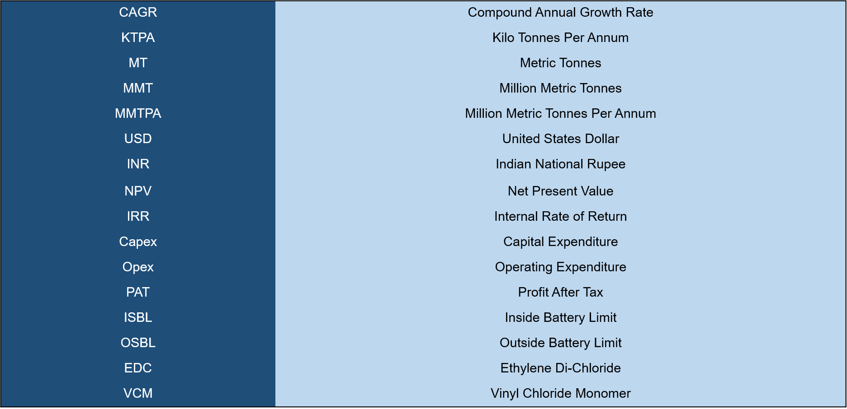
Abbreviations

Slide 53










Disclaimer :
The contents of this report are based on information generally available to the public from sources and primary interviews which are believed to be reliable. No representation is made that it is timely, accurate or complete. TechSci Research has taken due care and caution in compilation of data as this has been obtained from various sources including primary interviews which it considers reliable and firsthand. However, TechSci Research does not guarantee the accuracy, adequacy or completeness of any information and it is not responsible for any errors or omissions or for the results obtained from the use of such information and especially states that it has no financial liability whatsoever to the subscribers / users of this report. The information herein, together with all estimates and forecasts, can change without notice. All the figures provided in this document are indicative of relative market size and are strictly for client’s internal consumption. Usage of the same for purpose other than internal will require prior approval of TechSci Research.
CONTACT US
TechSci Research – North America
2950, Boundary Road, Burnaby, British Columbia, Canada
Tel: +1- 646- 360-1656
E: sales@techsciresearch.com
TechSci Research – Europe
54, Oldbrook, Bretton,
Peterborough,
United Kingdom
E: sales@techsciresearch.com
TechSci Research – Asia-Pacific
B-44, Sector -57, Noida, National Capital Region, UP, India
Tel: +91-120-4523900
E: sales@techsciresearch.com
TechSci Research
Cyber City, Building No. 8C, Gurgaon, National Capital Region, Haryana, India
Tel: +91-124-6428661
E: sales@techsciresearch.com
www.techsciresearch.com
INDUSTRY ASSOCIATIONS
2022 © TechSci Research All Rights Reserved.

